Slide 1
The Federal Patient Safety and Quality Improvement Act: A Prescription for a Culture of Safety
School of Health Technology and Management
TAANA 33rd Annual Meeting and Educational Conference
October 9-11 2014
Las Vegas, Nevada

Slide 2
School of Health Technology and Management
Ronnie McKinnon RN, JD, CPHRM, CPSO, CPPS
TeamSTEPPS® Master Trainer
Certified Just Culture Professional
Director, MS Healthcare Quality and Patient Safety
Clinical Assistant Professor
School of Health Technology and Management
Stony Brook University Health Sciences Center
Stony Brook, New York

Slide 3
This presentation is for educational purposes only and does not constitute legal advice.
School of Health Technology and Management

Slide 4
T
School of Health Technology and Management
The Federal Patient Safety and Quality Improvement Act of 2005*
“PSQIA” The Genesis
IOM: “To Err Is Human”
Patient Safety Improvements Thwarted
1) Health Care Providers Fear to report.
Statements used against them med mal, state
licensing boards…
2) Lack of Aggregate Adverse Event Data.
* Public Law 109-41, 109th Congress. Amends Public Health Service Act
42 U.S.C. § 299b-22

Slide 5
State Based Quality Assurance and Peer Review Statutes
School of Health Technology and Management
Insufficient Protection
Federal Court NO Medical QA/Peer Review privilege
Confusing
Uncertain (Burden of Proof, Waiver of privilege)
Some states no protection ( Kentucky, Florida)
Other states numerous exceptions
New York QA/ Peer Review Statutes*
Statements made at QA or Peer Review by a party defendant discoverable
NY DOH exception
* NY PHL 2805 j, k, l, m and NY Education Law 6527

Slide 6
The Federal Patient Safety and Quality Improvement Act of 2005*
School of Health Technology and Management
First Federal Based QA/ Peer Review Privilege
Did not become operational till 2009**
Privilege not automatic (must select PSO)
Specific steps must be taken to invoke the Federal Law privilege and confidentiality
Complex requirements→ PSO Certification
Did not take off as expected
*Legislative Intent: “…to provide for the improvement of patient safety and to reduce the incidence of events that adversely effect patient safety.”
**Implementing Regulations 42 CFR Part 3

Slide 7
The Federal Patient Safety and Quality Improvement Act * “The Patient Safety Act”
School of Health Technology and Management
1st ever Federal Based QA/Peer Review Privilege/Confidentiality
Authorized Creation of Patient Safety Organizations
“PSOs”
Mechanism for reporting and sharing Patient Safety Information (“PSWP”) without fear of liability/disclosure
Administered by Agency for Healthcare Research and Quality (AHRQ)
Enforced by Office of Civil Rights (OCR)
*42 U.S.C. § 299b-22

Slide 8
“PSO Lingo”
School of Health Technology and Management
PSO—Patient Safety Organization= receive and analyze Patient Safety Work Product.
15 requirements for “Certification” as a PSO by AHRQ.
HC Licensing and accreditation entities, health insurers are PROHIBITED.
“Decertification” by AHRQ for cause or voluntary decertification.
PSWP—Patient Safety Work Product= “…any data, reports, records, memoranda, analysis (such as root cause analysis), or written or oral statements which are assembled or developed for reporting to a PSO…, or which identify the fact of reporting pursuant to a PSES.
PSES—Patient Safety Evaluation System=mechanisms through which PSWP is identified, collected, aggregated, analyzed, maintained and communicated. It is whatever the HCP, HC Entity or organization defines as the mechanisms through which they engage in Patient Safety Activities for reporting to PSO.

Slide 9
Patient Safety Activities Patient Safety Activities—broadly t Safety Activities—broadly
School of Health Technology and Management
Efforts to improve safety and quality.
Collection and analysis of PSWP.
Development/dissemination of Patient Safety related information (best practices).
Utilization of PSWP to encourage culture of safety, feedback.

Slide 10
Patient Safety Work Product
School of Health Technology and Management
1)Information collected or developed by the HCP or
HC entity for reporting to the PSO.
2)Information developed by the PSO.
3)Information that identifies, constitutes the
deliberations/analysis or fact of gathering, collecting
within the Patient Safety Evaluation System (“PSES”).

Slide 11
The Patient Safety Act Privilege and Confidentiality*
School of Health Technology and Management
PSWP shall be privileged and shall not be
1) subject to a Federal, state, or local civil, criminal or administrative subpoena or order including in a Federal, state, or local civil or administrative disciplinary proceeding against a provider;
*42 U.S.C. § 299b-22 section 922

Slide 12
School of Health Technology and Management
PSWP shall be privileged and shall not be
2) subject to discovery in connection with a Federal, state or local civil, criminal or administrative proceeding, including in a Federal, state or local civil or administrative disciplinary proceeding against a provider;

Slide 13
School of Health Technology and Management
PSWP shall be privileged and shall not be
3) subject to disclosure .., under the Freedom of Information Act or any other similar Federal, state, or local law;

Slide 14
School of Health Technology and Management
PSWP shall be privileged and shall not be
4) admitted as evidence in any Federal, state, or local government civil proceeding, criminal proceeding, administrative rulemaking proceeding, or administrative adjudicatory proceeding, including any such proceeding against a provider; or

Slide 15
School of Health Technology and Management
PSWP shall be privileged and shall not be
5) admitted in a professional disciplinary proceeding of a professional disciplinary body established or specifically authorized under state law.

Slide 16
Notwithstanding any other law… PSWP shall be Confidential and shall not be disclosed.
School of Health Technology and Management

Slide 17
Exceptions to Privilege and Confidentiality Evidence of Crime
School of Health Technology and Management
Disclosure of Relevant patient safety work product for use in a criminal proceeding, BUT only after a court makes an in camera determination that such patient safety work product contains evidence of a criminal act, and that such patient safety work product is material to the proceeding and not reasonably available from any other source.

Slide 18
Exceptions to confidentiality
School of Health Technology and Management
Disclosure by provider to carry out Patient safety activities.
Reporting events to FDA by HC Provider or HC Entity.

Slide 19
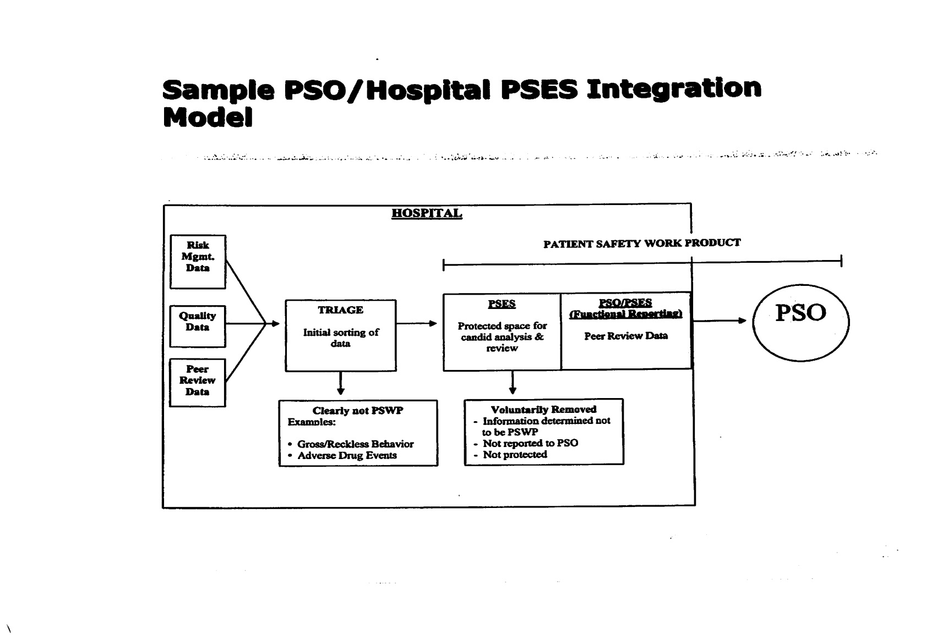
School of Health Technology and Management
PSO
2
PSO
3
Network
Of PS
Databases
PSO
1
RCA, analysis
1
NO
WHY?
Can’t use
For Medical Staff Privileges
Decisions,
adverse med staff actions
De-identified
Aggregated
The
“Lock Box”
Not PSWP
GOAL:
Disseminate for Patient Safety Learning
Medical Records
Not under PSQIA
BUT State Laws apply

Slide 20
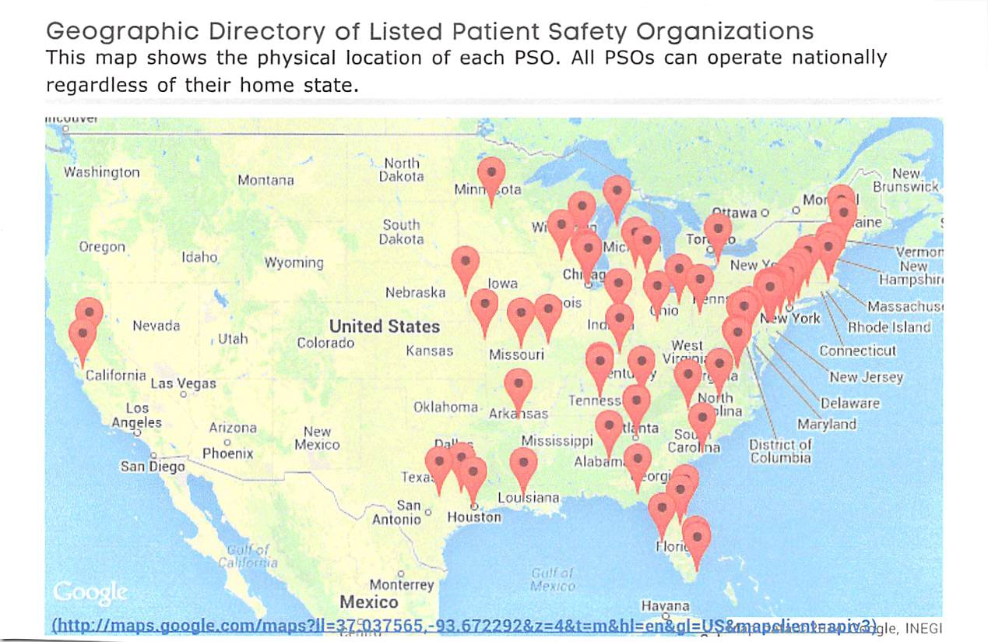
School of Health Technology and Management
Source: www.pso.ahrq.gov/listed/geographic

Slide 21
Legal Challenges
School of Health Technology and Management
Illinois Dept. of Financial and Professional Regulation v. Walgreen Co *
Patient Safety Work Product is Privileged under PSQIA
Illinois appellate court upheld lower court’s decision: Patient Safety Work Product (PSWP) is privileged and not subject to discovery under the
Patient Safety and Quality Improvement Act.
IDFPR (Pharmacy Licensing Disciplinary Board) subpoenaed “all incident reports of medication error” involving certain Walgreen’s Pharmacists who were under Pharmacy Disciplinary Board Investigation.
Walgreens asserted PSWP Privilege under PSQIA.
IDFPR moved to compel Walgreens --argued documents maintained for reasons other than for reporting to PSO.
Lower Court dismissed the petition based on PSQIA privilege.
IDFPR appealed.
*970 N.E. 2d 552 (Illinois Ct. App. 2012)

Slide 22
Walgreens Appellate Decision Relied primarily on two provisions of PSQIA: 1) The purpose of the PSQIA is to encourage a “culture of safety” and quality in the US healthcare system by providing for a “broad confidentiality and legal protections of information collected and reported voluntarily for purposes of improving the quality of medical care and patient safety.” 2)PSWP is defined as “any data, reports, records, memoranda, analyses, or written or oral statements which are assembled, or developed by a provider for reporting to a PSO and are reported to a PSO.”
School of Health Technology and Management

Slide 23
Charles v Southern Baptist Hospital*
School of Health Technology and Management
Issue: PSWP Privilege if state mandated report?
Court acknowledged PSQIA, Hospital’s PSES, PSWP—except court interpreted the information as part of a state mandated reporting information→ not cloaked in Federal PSQIA protection.
Hospital appeal.
*Case No 15-2012-CA-002677 Florida Trial Court

Slide 24
Gooden v CVS Caremark*
School of Health Technology and Management
Issue: PSQIA privilege apply where party admits liability?
Plaintiff demanded incident report from CVS arguing federal privilege does not apply where defendant had admitted liability.
Defendants countered: Congress intended to improve Quality of Care by creating a “Culture of Safety through non-punitive voluntary reporting and the Federal privilege applies even where liability admitted. Court: Agreed PSQIA protection applies.
*Case No. 11CAVA-10885 Ohio Trial Court

Slide 25
Tinal v Norton Healthcare, Inc.* (May 8, 2014)
School of Health Technology and Management
Issue: Scope of PSQIA beyond Medical Malpractice?
Wrongful Termination Employment under the ADA case
Plaintiff Pharmacist demanded production of RCA and other records related to her alleged errors and records of errors of her peers.
Norton Healthcare asserted Federal Privilege under PSQIA
Plaintiff countered that Congressional intent was PSQIA to apply to medical malpractice not wrongful termination in violation of federal civil rights cases.
Although court agreed Legislative Intent began there→ Is the scope of application of this PSQIA law described in the plain language of the law?
PSWP Privilege applies in “all federal, state, local, civil, criminal or administrative proceedings, with limited exceptions, none of which apply.”
Did Norton Health establish that the documents sought were PSWP?
In Camera Review 84 documents, all reported to PSO. Yes→PSWP.
*Civil Action No. 3:11-CV-596-S

Slide 26
School of Health Technology and Management
Reduce Risk of Discovery of PSWP
Signed, Dated Contract with certified, listed PSO
Define in writing your PSES --could be comprised of many processes/activities, computer systems …
Definitions/Policy and Procedures related to what is PSWP, data collected, deliberations, RCA meetings, databases, meetings, committees and written and oral communications, reporting to PSO, processes, who has access, where stored, who is authorized to report PSWP to PSO…
Who will decide what gets reported to PSO
Be prepared to educate: Outside Counsel, Judges, Disciplinary Board Prosecutors…

Slide 27
School of Health Technology and Management
Reasons to Participate with PSO
PSQIS privilege applies to all state licensed providers–
NOT just hospital QA Peer Review.
Broader protection than state privilege.
PSQIA protections co-exist with state law privilege.
Some states (Missouri) require providers to report to PSO to treat Medicaid pts.
CMS certified Accountable Care Organizations must report PSWP to PSO in order to negotiate with insurance exchanges.
Contribute to the Patient Safety Improvement Culture

Slide 28
School of Health Technology and Management
Questions
Contact Information:
Ronnie McKinnon
ronnie.mckinnon@stonybrook.edu
631-444-6689

