Slide 1
Exploring Federal Regulatory Approaches
to Safe Nurse Staffing
Sofia Aragon, JD, BSN, RN
Executive Director
Washington Center for Nursing

Slide 2
Objectives
What federal regulatory strategies are available to enforce better standards for nurse staffing in hospitals?
How can we work with nurses to assure standards are held?
What could be the impact of public awareness and education about this issue?

Slide 3
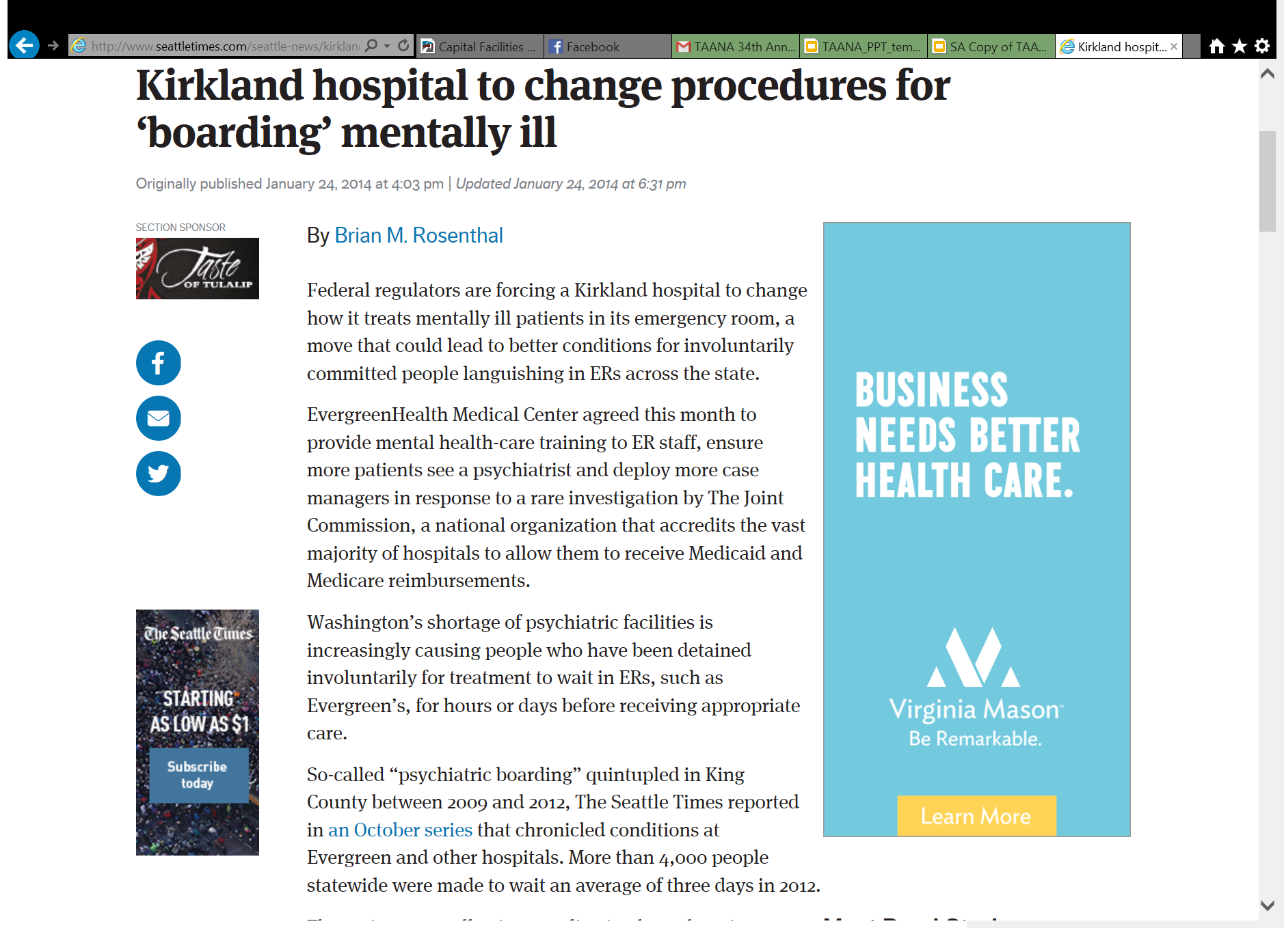
Notes:
Link to Seattle Times article: http://www.seattletimes.com/seattle-news/kirkland-hospital-to-change-procedures-for-lsquoboardingrsquo-mentally-ill/

Slide 4
Federal Regulatory Enforcement
In January 2014, the Seattle Times reported that the Joint Commission on Accreditation of Healthcare Organizations (JCAHO) had performed an unannounced investigation at Evergreen Medical Center.
The Commission required Evergreen to change their procedures in order to provide better conditions for patients involuntarily committed in the ER

Slide 5
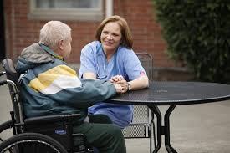
Federal Regulatory Enforcement
“When the Joint Commission talks, the hospitals listen because it’s their federal money.” Representative Tami Green, BSN, RN

Slide 6
Regulatory Framework
Office of the
Inspector General
Centers for Medicare and Medicaid Services
(CMS)
Investigates Fraud
Conditions of Participation
WA State Department of Health
The Joint Commission
Enforces state & federal laws
Conducts hospital surveys
Investigates complaints
Accreditation Standards
Deeming Authority for CMS
Notes:
Deeming authority means that hospitals accredited by an organization with deeming authority can elect to be "deemed" as meeting CMS requirements based on successful accreditation by the other organization.

Slide 7
Applying the Regulatory Framework
Department of Health
Complaint Investigations
Joint Commission
Investigation Surveys
State law enforcement
What types of conduct will trigger an investigation?
Contracts with Medicare to investigate complaints based on Medicare Conditions of Participation
What is the process for a complaint investigation with the DOH?
Goal/Outcome: Enforcement of standards to support safe nurse staffing and patient safety
What is the process for enforcing accreditation standards in hospitals?
What are the challenges to filing a complaint with JCAHO?
Resources and strategies in filing a complaint to get the response you want

Slide 8
What does the DOH investigate DOH Complaint Process
Adverse health events
Patient abuse or neglect
Staff not available to provide care
Failure to provide care
Providing the wrong care
Medication errors
Not following medical orders
Unsafe or unclean conditions in the facility
Patient injuries and falls
Not responding to patient complaints

Slide 9
DOH Complaint Process
Complaint of Violation of State Law is received
Initial assessment by an internal committee
Investigation
Corrective Action

Slide 10
Complaint Process for CMS or JCAHO violations
Complaint of Violation of Federal Law is received
Initial assessment and communication to DOH
Investigation
Corrective Action
Notes:
Question: between DOH and Medicare—what’s the bigger hammer and why?

Slide 11
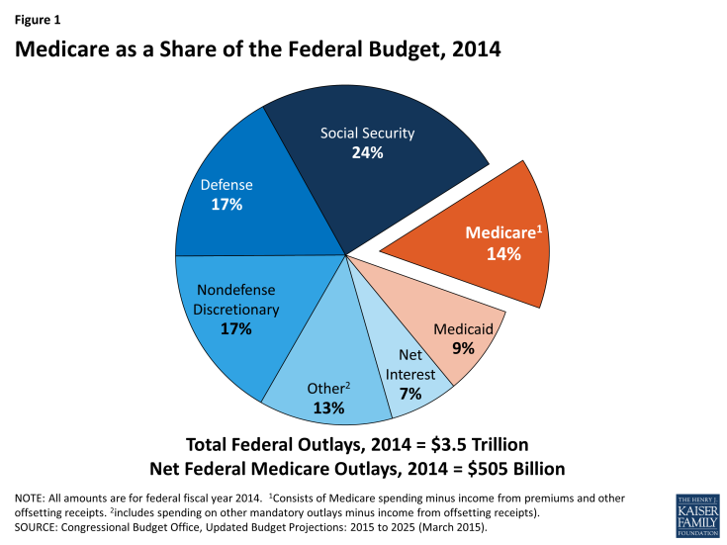
Notes:
http://kff.org/medicare/fact-sheet/medicare-spending-and-financing-fact-sheet/
Medicare benefit payments totaled $597 billion in 2014; roughly one-fourth was for hospital inpatient services, 12% for physician services, and 11% for the Part D drug benefit (Figure 2). Another one-fourth of benefit spending was for Medicare Advantage private health plans covering all Part A and Part B benefits; in 2015, 31% of Medicare beneficiaries are enrolled in Medicare Advantage plans.⁴

Slide 12
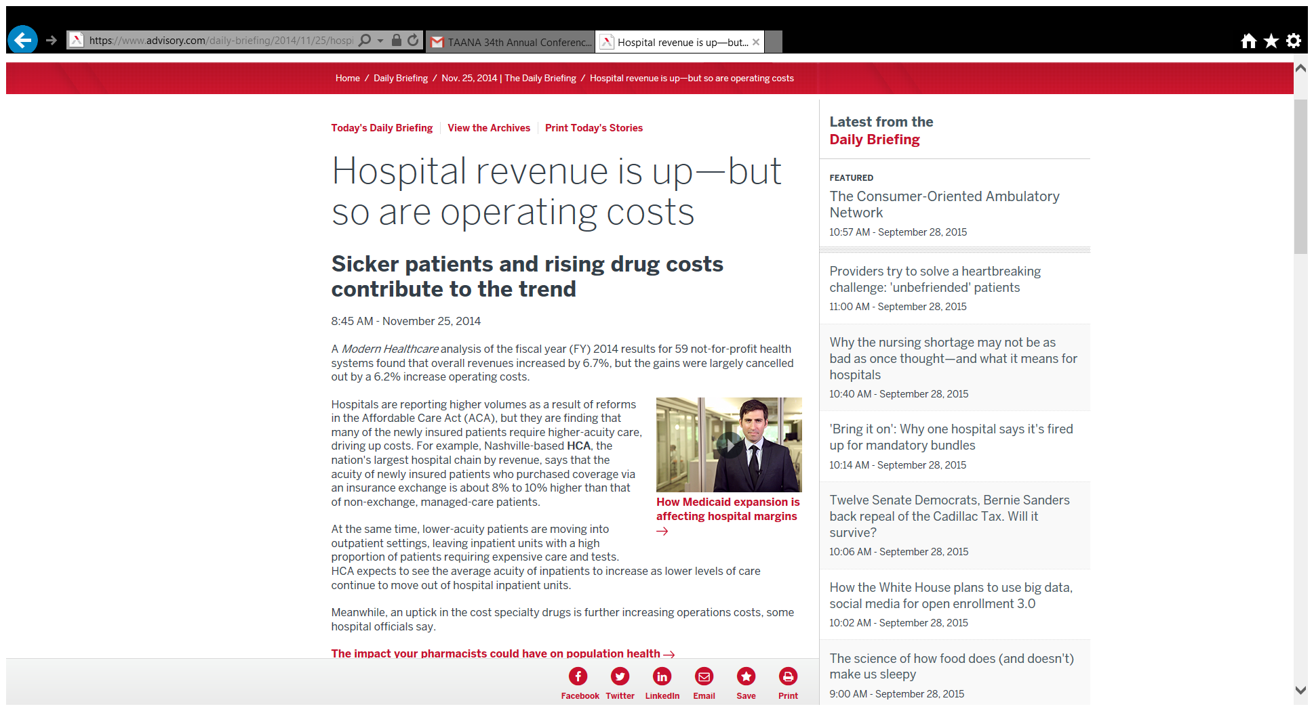

Slide 13
JCAHO Complaint Process
How are accreditation standards enforced?
JCAHO’s Office of Quality Monitoring may conduct an unannounced investigation in response to complaints or reports of an undesirable event or conditions in hospitals
Once an investigation is completed, hospitals have 45-60 days to correct any deficiencies and show evidence of compliance with accreditation standards

Slide 14
JCAHO Complaint Process
What are the challenges to this process?
Unclear what types of complaints will trigger an investigation
JCAHO standards related to nurse staffing are vaguely defined
JCAHO does not release any detailed records related to survey results, investigation findings, or hospital accreditation decisions to the public.
Records related to survey results, investigation findings, or hospital accreditation decisions can be requested through the federal Freedom of Information Act

Slide 15
Medicare Conditions of Participation
What are important comparisons to JCAHO?
Conditions of Participation include adequate nurse staffing found in Title 42 Sec. 482.23
The Association of Health Care Journalists established hospitalinspections.org providing records of complaints against hospitals resulting in citation

Slide 16
Conclusions
The role of the Joint Commission
Joint Commission accreditation surveys provide an important vehicle for reducing risk and fostering improvement.
But the accreditation survey process is unlikely to detect substandard patterns of care and accreditation is rarely denied.
Sets goals rather than minimum standards.
Focus on education and improvement rather than regulation and enforcement.

Slide 17
Conclusions
The Role of the Department of Health?
In 2013, the DOH rolled out a new “Lean” approach for conducting hospital surveys at larger facilities intended to improve patient safety through a more effective inspection process.
Because of the new survey approach, the DOH complaint investigation process to regulate hospital conduct and enforce standards under state and federal law is a more threatening hammer.

Slide 18
Conclusions
Importance of the Complaint Process
Complaint investigations are an important enforcement tool because they offer a timely, publicly accountable means for responding to complaints and adverse events
DOH is the lead for state law violations
Coordination on response to federal violations by CMS
But this process is not without limitations
Agency discretion to act on a complaint with regards
to violation of state law
Enforcement capacity

Slide 19
Recommendations
How do we use the complaint process effectively?
File timely complaints regarding unsafe staffing and link the staffing to risk to patient safety
Multiple complaints help
The Seattle Times article on psychiatric boarding shows that complaint investigations can result in public pressure on a hospital to a change practices that put patients at risk

Slide 20
Exercises

Slide 21
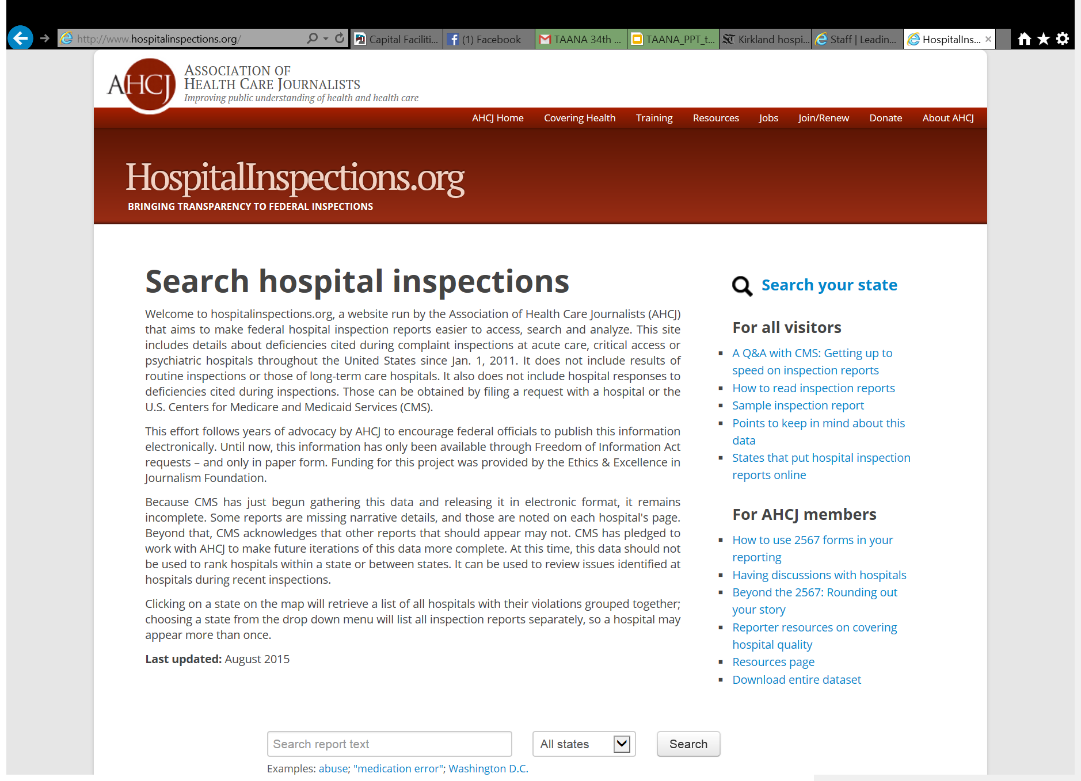

Slide 22
Research through www.hospitalinspections.org
Find an example for your state:
Search subject, eg “staffing” or “nurse”
Enter the state
Using examples as a model for a potential complaint:
What level of detail is used to describe treatment received? Medications used?
What evidence is used to show that appropriate staffing standards were adhered to?

Slide 23
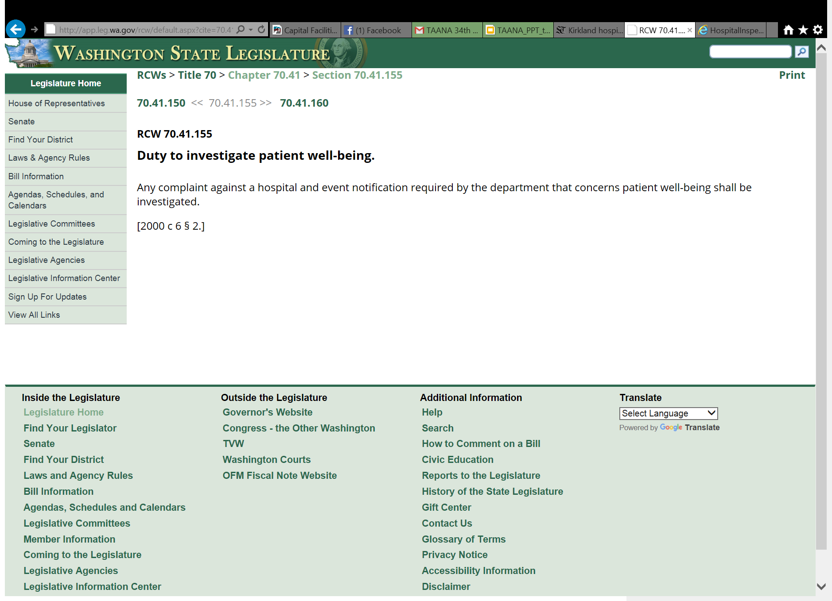
WA Statute to Compel Investigation

Slide 24
Is Patient Death Required?
No!
Review St. Joseph Medical Center 8/13/12
The hospital’s failure (to provide care in a safe setting) resulted in pain, fear, and discomfort for Patient #1, and placed all patients who underwent injections in the Nuclear Medicine department at risk for the same…
Patient neglect: the hospital’s failure to do so resulted in pain, fear, and discomfort
Notes:
http://www.hospitalinspections.org/report/2201

Slide 25
Recommendations
Learn from available complaints
Hospitalinspections.org provides information on hospital citations
You can search for key words. Examples including “nursing” or “staffing”
The complaint need not show actual death or injury, but risk of patient harm

Slide 26
Role of nursing groups?
Raise nurse awareness of the importance of using the complaint investigation process to hold hospitals to current regulatory standards
Survey nurses to gather scenarios where nurse staffing issues compromise compliance with regulations and result in risk to patient safety
Support RNs to improve their ability to describe the link between safe staffing, compliance with standards and patient outcomes = strong complaints
Notes:
Use written example provided by staff nurse

Slide 27
Questions?
Sofia Aragon, JD, BSN, RN
Executive Director
Washington Center for Nursing
206.556.9670
SofiaA@wcnursing.org

