Slide 1
CROSS EXAMINATION OF PHYSICIANS AND NURSES
KATHLEEN P. KETTLES, RN, BSN, JD
WINGATE RUSSOTTI SHAPIRO & HALPERIN, LLP – NEW YORK CITY

Slide 2
Preparation
THERE IS NO ONE RIGHT WAY!
FOR EVERY ARTICLE WITH “COMMANDMENTS” FOR CROSS EXAMINATION, YOU CAN FIND ANOTHER ARTICLE WHICH CONTRADICTS THE COMMANDMENTS.
HOWEVER, PREPARATION IS KEY. YOU MUST BE A MASTER OF THE FACTS, THE LAW AND THE MEDICINE.
CROSS FOR TRIAL STARTS AT DEPOSITION. See, 1 Medical Malpractice Checklists and Discovery, §§ 8.17, 8.35.
Study Great Cross Examiners. 3 American Law of Medical Malpractice § 20:2. ( Trial of a Complex Hematology Wrongful Death Action).
2

Slide 3
FACT MATERIALS FOR CROSS IN MEDICAL MALPRACTICE ACTIONS
MEDICAL RECORDS: BEFORE BOTH DEPOSITION AND TRIAL – CERTIFIED EMR’S OR COPIES.
HOSPITALS, OTHER FACILITIES,DOCTORS, PT, OT, SPEECH THERAPIES, PHARMACIES, EMPLOYMENT PHYSICALS, WORKERS COMP EVALS, SOCIAL SECURITY DISABILITY FILES, HOME CARE SERVICES, PSYCH EVALS, CERTIFIED HOSPITAL BILLS, HEALTH INSURANCE RECORDS, RADIOLOGY FILMS/CD’S.
SUBPEONA RECORDS AT LEAST 45 DAYS BEFORE TRIAL. AGREEMENT OR SERVE AUTHENTICATION DOCS. (NY CPLR SECTIONS 3122-a and 4532-a)

Slide 4
Other Fact Materials
CV’s
MD, RN, NP Depositions
Defendant/Expert Publications
Internet Searches for Web Sites, Blogs, etc.
Disciplinary Materials
Prior Depo’s or Trials Transcripts
ACTIONS: Outline Pertinent Depositions using Pen/Paper, PDF File with Annotations, Cut/PasteTestimony into Cross outline, Dictation Nuance Legal/Medical Dragon Speech Recognition.

Slide 5
The Law
Admissibility of Statements in MR – For example: Patient fell while crossing against the red light.
Frye/Daubert Motions – Reliability of expert’s testimony – is challenge warrented.
Motions in Limine – Prep. For Admission of or Exclusion prior bad acts as having/lacking probative value on issues and too prejudicial. Example: MD with sanction from professional society. Problems can be turned into opportunities.
Preparation of Charge for Jury – Pattern Jury Instructions and model questions concerning departures, causation on language used in the charge.
5

Slide 6
The Medicine
Medical Subject Areas - Obstetrics
Neonatology – HIE, Infections, Genetics, Metabolic
Placental Pathlogy = Prenatal Insult?
Pediatric Neuroradiolgy = Type of Insult, Timing
Maternal Fetal Medicine = Prenatal antecedents, EFT’s
Other Defenses
Use cross to educate jury on what is Neonatology, Importance of placental pathology and what it shows, etc.
Out of your mouth? Or, out of the mouth of the defendant MD, NP, RN? Best is to mix it up.

Slide 7
Process
Extracting Relevant Facts from MR
Outlining Deposition Testimony
Statutes: Nurse Practice Acts
Documentary Evidence – Rules, Regs, Guidelines, etc.
Admissions
Medical Literature

Slide 8
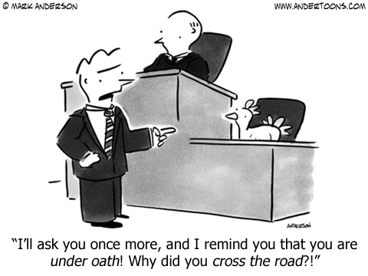

Slide 9
TOPICS FOR CROSS EXAMINATION
1. Credentials:
Nurse for 11 years
BS in Nursing
Employed at
Telemetry Unit
Employment:
Working at John Smith Hospital for last 8 years
All of the eight years as a night nurse on M/S unit
Testified that you’ve only worked in telemetry if short
3. Training:
Never took ECG course
Cannot read ECG beyond some basic rhythms – NSR, V FIB
4. September 8, 2011
Told to report to telemetry despite lack of knowledge
One other RN for 8 bed unit
Mrs. X was your patient that evening
Dx Unstable Angina – admitted that day – no prior cardiac history – no c/o chest pain – vs stable.
Unstable Angina is a condition……
Important to monitor closely due to increased liklihood of MI
Complained of some indigestion at 12 midnight
Given Maalox
.

Slide 10
CROSS CONT’D.
Alarms: -Obligation to check working and parameters
-respond
- alarm fatigue
Nursing Actions:
-Take print out – call if tracing abnormal
-go to patient -Assessment VS, HS, Resp. Pattern, S & Sx, put on O2, get 12 lead ECG, Second IV.
September 18, 2011
- Patient unconscious, pulseless, not breathing, code called. Expired at 215 am.
- Review of 11pm tracing shows myocardial ischemia
- risk to patient is development of arrthymia
- untreated ischemia/arrythmias result heart not pumping effectively
- results in decreased oxygen to heart, brains, stops breathing, brain damage or death.
Nurse Smith
you failed to properly set alarms, respond to alarm
unable to read tracing
didn’t inform other trained nurse
as a result, decreased oxygen/circulation to heart, develop fatal arrthymia, cannot be
resuscitated and dies.
-

Slide 11
Summation
If you write your summation in outline during preparation for trial then you have a road map for where you want to go.
Just like essays at the beginning of preparing for the Bar exam – you don’t have to do it perfectly just an outline.
“Talk to you now about what the evidence has shown in this case.”
Ms. Smith, pleasant woman, put in a bad situation by HSP, not properly trained, did not understand alarm system, could not read ECG tracings, didn’t have knowledge of S & S of UA, MI, cardiac ischemia. Failed to respond appropriately. Loss of hours resulting in dev’p of arrhythmia causing increased hypoxia/ischemia, inability to resuscitate, death.

Slide 12
Electronic Medical Records – EMR/EHR
The Health Insurance Portability and Accountability Act of 1996 (“HIPAA”) sets out a comprehensive set of rules, safeguards, and definitions that are, effectively, applicable to most health care providers that use computers and electronic storage devices to store or transmit patient medical records. With the HITECH Act’s incentives to use electronic health records, more and more providers will do so.

Slide 13
EMR
Under HIPAA, Protected Health Information(“PHI’) is “individually identifiable health information” that is:
i. Transmitted by electronic media;
ii. Maintained in electronic media; or
iii. Transmitted or maintained in any other form or medium.

Slide 14
PHI AS ELECTRONICALLY STORED INFORMATION
To understand where and how EMR systems “transmit” and “maintain” PHI, it is helpful to use the terminology of computer experts. From their viewpoint, HIPAA’s PHI is Electronically Stored Information (“ESI”).
ESI is data stored, processed, retrieved or transferred by “Electronic Storage Devices.” Electronic Storage Devices – a subclass of Electronic Media – are commonly known as diskettes, Flash Drives and CD/DVD Disk media. Both Electronic Storage Devices and Electronic Media are capable of containing ESI (thus PHI).
Electronic Storage Devices capable of storing ESI can be classified into two main categories – Non-Volatile Electronic Storage Devices and Volatile Electronic Storage Devices.
Non-Volatile Electronic Storage Devices store data on a more or less permanent basis, but can often be deleted or destroyed. These can be grouped into several categories – Primary Storage Devices, Secondary Storage Devices, Offline Backup/Archival, and “In the Cloud.”

Slide 15
Non-Volatile Storage Devices
Non-Volatile Electronic Storage Devices store data on a more or less permanent basis, but can often be deleted or destroyed. These can be grouped into several categories – Primary Storage Devices, Secondary Storage Devices, Offline Backup/Archival, and “In the Cloud.” Examples of each are:
Primary Storage Devices
(1) Hard Disk Drives
(2) Disk Media
(3) ROM / PROM / EPROM
(4) Solid State Drives (Flash Storage)
(5) SIM Cards
(6) Multi Media Cards (SD, SDHC, SDXC, SDIO, and Others)
(7) Smart Cards, Chip Cards or Integrated Circuit Card
(8) Paper Based Storage (Punch Cards, Bar Codes, Scantron)
Secondary Storage Devices
(1) USB Thumb Drives / Flash Drives
(2) External Hard Disk Drives
(3) Disk Media (Floppy Disk, CD, DVD, Blue Ray)
(4) Radio-Frequency Identification (RFID) Tags
Offline Backup / Archival
(1) Magnetic Tape
(2) Disk Media (Floppy / CD / DVD / Blue Ray)
(3) Bar Code Paper Records
(4) CD / DVD Disk Media

Slide 16
Volatile Storage of EMR
In the Cloud (Utilizes all types of Storage).
Volatile Electronic Storage Devices retain a good deal of ESI for a discrete period of time, e.g. until such time that the Volatile source loses power. The RAM in a computer is an example of Volatile Electronic Storage Devices.
ESI may be transmitted between Electronic Storage Device sources via the internet, extranets, infrared, radio, Wi-Fi, Satellite, Cable, Broadband, cellular, leased lines, barcode, dial-up telephone lines, private networks, connected external devices, and devices that are physically moved from one location to another using magnetic tape, disc, or compact disc media.
A patient’s PHI maintained in any of these Electronic Storage Devices or transmitted by any of these means of electronic tranmission are potential sources of discoverable information. Smart phones and PDAs are increasingly used in association with electronic health data. Industry sources estimate that in 2010, more that 50 percent of physicians were using smartphones or PDAs on a regular basis in clinical decision making.

Slide 17
Metadata – Data About Data
In order to implement the Privacy and Security Rules, HIPAA requires covered entities to use “audit controls,” such as “hardware, software, and/or procedural mechanisms that record and examine activity in information systems that contain or use electronic protected health information” and to “implement procedures to regularly review records of information system activity, such as audit logs, access reports and security tracking reports.” The Metadata generated by these audit control systems, about the access and use of a patient’s records and the use and operation of the computer device maintaining or transmitting the records, is typically not part of the formal medical record. But it can often be a gold-mine of important information that would not otherwise be obtainable in discovery.
For example, Metadata in the form of an audit log or audit trail may be helpful with faulty or incomplete memories. An audit trail is a record of who, when, where, how and sometimes why a person used a computer program or acessed a patient’s medical record. Typically, the identity of the user who accesses the patient’s record, the time of access, the terminal or device used for access, the action taken by the user (i.e., viewing the record, changing the record), and the substance of anything added to the record and any changes or corrections made by the user are recorded in the Metadata which can be reproduced in the form of an audit trail or log. In a case known to the authors, a hospital audit trail produced during discovery, showing the “terminal identifier” for an EMR entry (the unique number assigned to each computer terminal in the EMR system) resulted in a nurse changing her testimony when it disclosed she was using a computer terminal in another part of the hopsital, and was not with the patient, as she had testified.
Metadata, such as in an audit trail, is captured automatically by the EMR system. As a result, the audit trail should correspond, entry by entry, to the patient’s medical chart or record. If an entry in the audit trail shows data was added, changed or deleted, a corresponding entry should appear in the patient’s chart, and vice versa.
Metadata found in a forensic image of a medical record may be more helpful. A “forensic image” is not simply a copy of the electronic record; it is a bit-for-bit copy of all sectors of the media involved and must be done properly. Example: Metadata on a video disk of a surgical procedure produced during discovery showed that the several of the video clip files in the series of video files that were generated during the procedure were deleted, with the remaining video clips renumbered in an apparent attempt to conceal what transpired during the missing video clips.

Slide 18
Admissibility of Metadata
Recorded Metatdata in an EMR system is similar to images recorded on surveillance cameras, which are not hearsay. People v. Tharpe-Williams, 676 N.E.2d 717, 286 Ill.App.3d 605 (1997).
Because Metadata involves no human input in its creation, other than the actions taken by the user in creating or manipulating the file or record referenced by the Metadata, it is non-hearsay evidence.
To the extent that Metadata does include human input, utilize rules which provide a hearsay exception for a memorandum, report, record, or data compilation, in any form, of acts, events, conditions, opinions, or diagnoses kept as part of a regularly conducted business activity.

Slide 19
Why Be a Medical Malpractice Trial Attorney?
You can advocate for patients or providers.
Natural extension for nurses to advocate for the rights of their patients or for the right to advocate for their profession and other allied professions.
There is no better feeling knowing that you have done something that the individual, patient or provider, could not do for themselves.
It’s hard, but interesting and rewarding work.

Slide 20
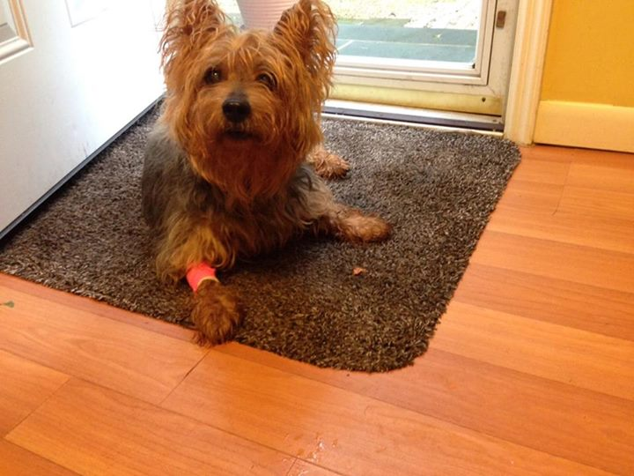
Thank You!

