Slide 1
Robotic Surgery Liability Risks: Trends in Claims Data and Loss Prevention
Laura Nordberg, Clinical Loss Control Director, CHE Trinity Health
The American Association of Nurse Attorneys (TAANA)
33rd Annual Meeting and Educational Conference
Las Vegas, Nevada
October 11, 2014

Slide 2
Objectives
Define robotic surgery.
Identify the basic equipment used during robotic surgery and how it works.
Describe the robotic surgery claims data trends evident from one health care system.
Describe how to build a successful robotic surgery program.
Describe how to manage risks inherent within a hospital’s robotic surgery program.

Slide 3
What is da Vinci® Robotic surgery?
“A surgical procedure or technology that adds a computer technology-enhanced device to the interaction between a surgeon and a patient during a surgical operation and assumes some degree of control heretofor completely reserved for the surgeon”. (Journal of GI and Endo Surgery)
Minimally-invasive surgery (MIS)
Approved by the FDA in 1997
Intuitive Surgical Inc. sales began in 1999
Advantages: clinical, ergonomic, financial, reputational
Limitations: cost, training, lack of outcome data, procedures over multiple quadrants

Slide 4
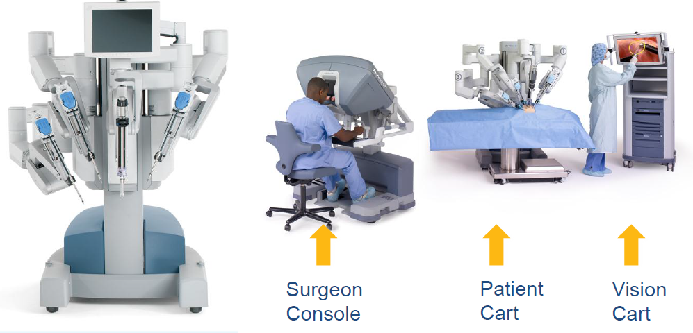
Da Vinci® robot: 3 components
The surgeon is physically separated from the patient

Slide 5
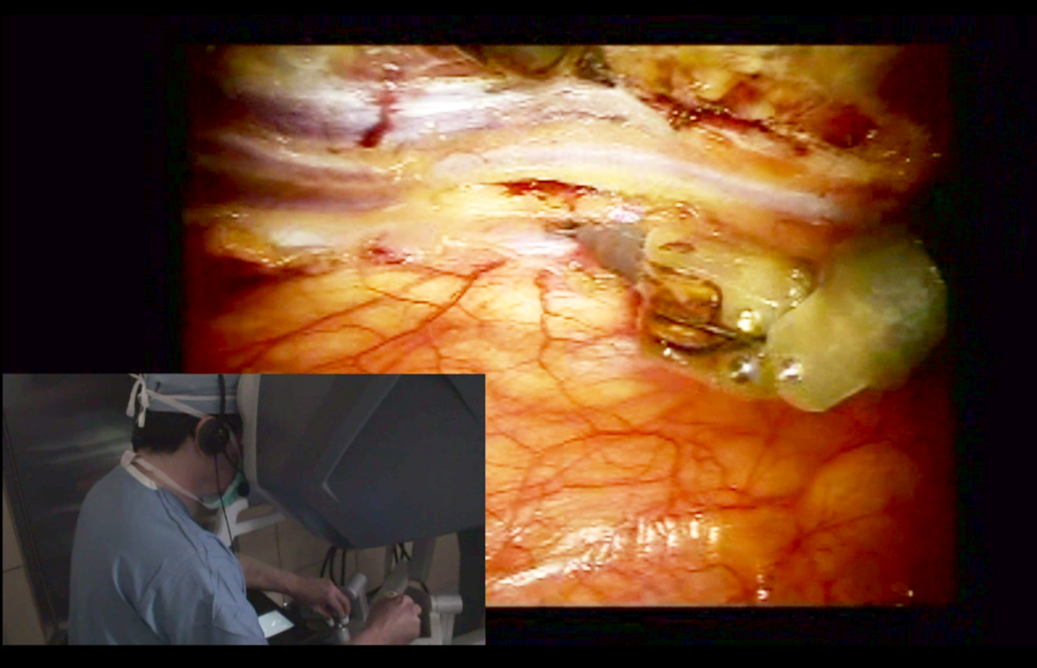
The Vision System
Surgeon is immersed in a 3-Dimensional image of the surgical field.

Slide 6
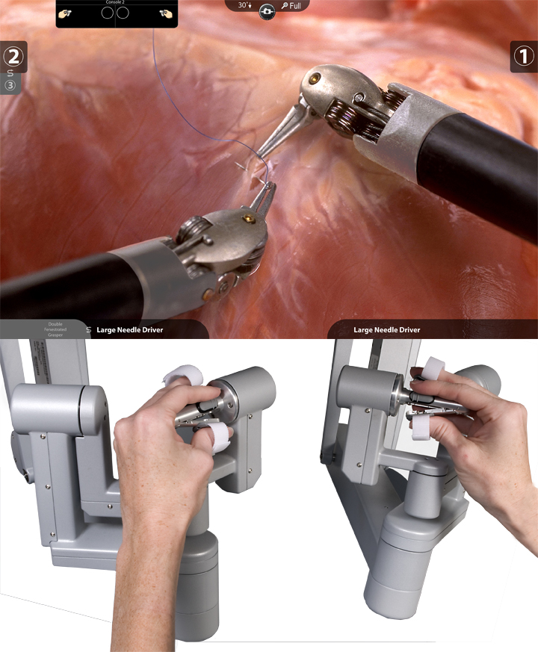
Surgeon Directs the Instruments
The surgeon’s hands are placed in special devices called “masters” that direct the precise instrument movements
2-5 second delay between surgeon’s direction and robotic movement
Up to 30 #lbs of pressure

Slide 7
Robotic surgical equipment

Slide 8
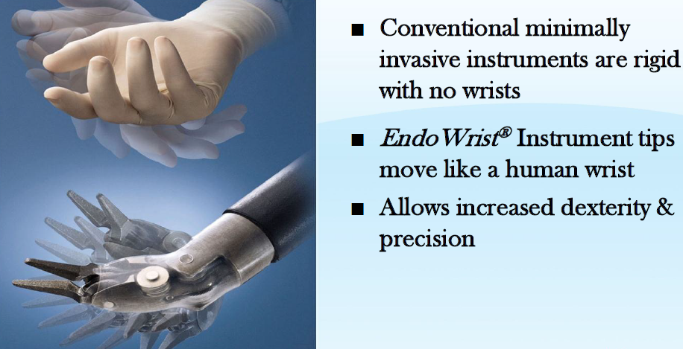
Robotic instruments have improved flexibility over traditional laparoscopic instruments
Mimics wrist and finger movement

Slide 9
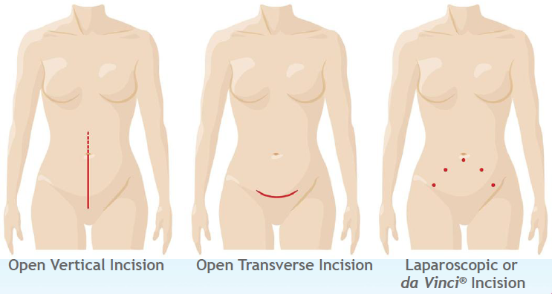
Clinical Advantages
Minimally-invasive; small keyhole incisions
3-D magnified visualization internally
Decreased blood loss
Lower risk of infection

Slide 10
Development of Recommendations
SURS (Society of Urologic Robotic Surgery)
SAGES (Society of American Gastrointestinal & Endoscopic Surgeons)
MIRA (Minimally-Invasive Robotic Association)
RTN (Robotic Training Network): Residency training at 9 hospitals
FRS (Fundamentals of Robotic Surgery: International Consensus Conference--2004)
ACOG (American College of Obstetrics and Gynecology): President’s Message 3-14-2013

Slide 11
Robotic Case Mix
9.5%

Slide 12
Da Vinci® Related Claims Frequency Has Trended Upward From FY09 Through FY12
Report includes claims with loss dates from 7/1/06 through 6/30/13, valued at 7/31/13. Zero dollar claims are excluded from this analysis. Please note that since HPL claims may take years to get reported and fully develop, it is too early to establish a trend for the years FY12 and FY13.
12

Slide 13
The Number of Robotic Assisted Procedures Performed Has Quintupled From FY09 to FY13
ICD-9 procedure codes were created in November 2008 in order to identify when robotics were utilized in the procedure. Significant shift over time from Inpatient to Outpatient driven by Hysterectomies, not Prostatectomies.
13

Slide 14
The Upward Trend In Claims Frequency Is Not Nearly As Pronounced, Relative to the Number of Procedures Performed
Report includes claims with loss dates from 7/1/06 through 6/30/13, valued at 7/31/13. Zero dollar claims are excluded from this analysis. Please note that since HPL claims may take years to get reported and fully develop, it is too early to establish a trend for the years FY12 and FY13.
14

Slide 15
The Three Most Frequent Causes Comprise 60% of Robotics-Assisted Surgery Claims Frequency, But Only 33% of Total Incurred Indemnity
Report includes claims with loss dates from 7/1/06 through 6/30/13, valued at 7/31/13. Zero dollar claims are excluded from this analysis. Note that in this chart, the black vertical line represents the range of incurred indemnities for each cause, i.e. lowest to highest.
15

Slide 16
First Leading Cause (Frequency): Improper Performance of Surgery
Physician experience
Simulation
Learning Curve: initial and maintenance
Credentialing: initial and maintenance
Cost assessment: variable, fixed, total
Quality Metrics
Length of surgery
Length of stay
Complication rate
Readmission rate

Slide 17
Robotic Surgery Complication Rates Directly Correlate with Surgeon’s Level of Robotic Experience

Slide 18
First Leading Cause (Frequency): Improper Performance of Surgery (continued)
Equipment Issues
Multiple “lives” of equipment accessories
Intuitive Surgical litigation philosophy
FDA database: MAUDE reports

Slide 19
Sample notice letter from Intuitive Surgical, Inc:

Slide 20
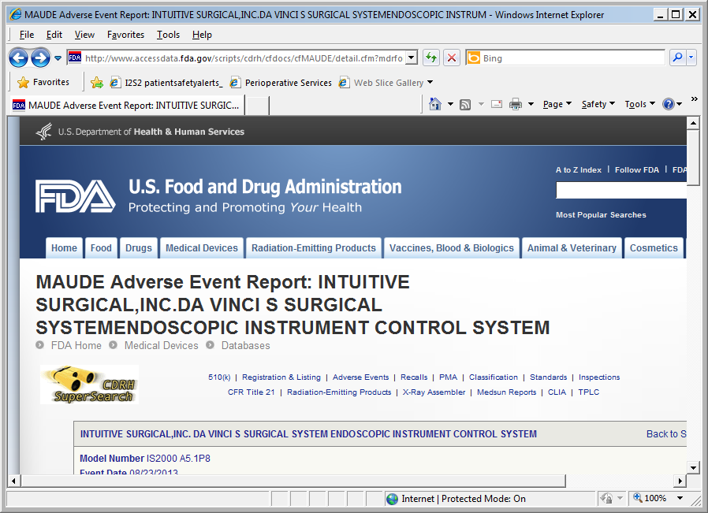
Sample FDA MAUDE Report

Slide 21
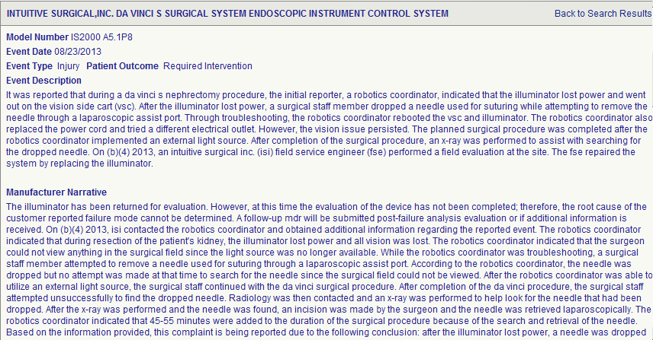
Sample FDA MAUDE Report 8/23/2013

Slide 22
First Leading Cause (Frequency): Improper Performance of Surgery (continued)
Patient movement issues
Surgical table stabilization
CO₂ supply
Gravity (sliding down while in trendelenberg)
Patient Factors
Correct candidates
Co-morbidity analysis
Informed consent discussion
Other Factors
Marketing / Consumerism*
Observation by Anesthesia
Housekeeping
Surgical team: 10% rule*

Slide 23
Current da Vinci® Volume
Location | Urology | GYN | General Surgery | Colorectal | Single Site | Thoracic | Cardiac | ENT
Hospital B | 126 | 254 | 0 | 0 | 0 | 53 | 1 | 12
Hospital W | 48 | 70 | 5 | 10 | 0 | 0 | 0 | 0
Hospital R | 0 | 83 | 34 | * | 3 | * | 0 | 0
Hospital M | 88 | 193 | 0 | 29 | 0 | 44 | 0 | 0
Hospital E | 128 | 564 | * | 0 | 0 | 30 | 0 | 0
Hospital S* | 57 | 161 | 24 | 0 | 0 | 0 | 0 | 0
Hospital X | 13 | 79 | 20 | 0 | 2 | 1 | 0 | 0
Hospital A | 44 | 310 | 33 | 27 | 23 | 0 | 0 | 0
Hospital V* | 46 | 154 | 9 | 0 | 12 | 34 | 0 | 0
Hospital U | 40 | 284 | 0 | 0 | * | 1 | 0 | 0
Hospital O | 107 | 90 | 16 | 22 | 0 | 0 | 0 | 0
Hospital J | 4 | 451 | 0 | 0 | 0 | 0 | 0 | 0
Hospital N | 85 | 86 | 26 | 0 | 0 | 1 | 0 | 0
Hospital F | 175 | 273 | 18 | 75 | * | 28 | 52 | 33
Hospital I | 47 | 184 | 3 | 47 | 0 | 13 | 0 | 0
Hospital C | 43 | 131 | 42 | 12 | 13 | 0 | 0 | 0
* Under development or consideration

Slide 24
Second Leading Cause (Frequency): Improper Positioning in Surgery
25-30 degrees of trendelenberg (GYN, Prostate)
Increased ICP
Ocular pressure
Cardiorespiratory compromise
Nerve injuries
Head/scalp
Neck and shoulder: brachial plexus
Forearm: ulnar nerve
Lithotomy position: groin and peroneal nerve injuries
Increased length of surgery
Pulmonary embolism
Pressure ulcers
Unstable blood sugars
Prolonged anesthesia time

Slide 25
High Severity Causes: Delay in Diagnosis in ER / Failure to Treat
Whether or not you have a robotic surgery program, you will see these patients in your ED
Post-operative trajectory is different
Assessment of post-operative complaints

Slide 26
National Benchmarks Indicate Higher Claims Frequency at Both Smaller and Larger Hospital Robotics Programs
National Benchmark
Report includes claims with loss dates from 7/1/06 through 6/30/13, valued at 7/31/13. Zero dollar claims are excluded from this analysis. Note that in this chart, the black vertical line represents the range of incurred indemnities for each cause, i.e. lowest to highest.
26

Slide 27
Robotic Assisted Claims Frequency by Location
Location | # Claims
Hospital E | 6
Hospital F | 4
Hospital J | 3
Hospital A | 3
Hospital I | 2
Hospital B | 1
Hospital L | 1
Hospital C | 1
Hospital D | 1
Physician Group H | 1
Physician Group G | 1
Hospital K | 1
Hospital M | 1
Hospital N | 1
Hospital O | 1
TOTAL # CLAIMS | 28
Report includes claims with loss dates from 7/1/06 through 6/30/13, valued at 7/31/13. Zero dollar claims are excluded from this analysis.
27

Slide 28
Robotic Assisted Claims Severity by Location
Location | Incurred Indemnity
Hospital A | $1,505,999
Hospital B | $750,000
Hospital C | $700,000
Hospital D | $700,000
Hospital E | $439,267
Hospital F | $217,500
Physician Group G | $180,000
Physician Group H | $100,000
Hospital I | $90,000
Hospital J | $25,652
Hospital K | $19,000
Hospital L | $11,500
Hospital M | $10,000
Hospital N | $0
Hospital O | $0
TOTAL INCURRED INDEMNITY | $5,498,918
Report includes claims with loss dates from 7/1/06 through 6/30/13, valued at 7/31/13. Zero dollar claims are excluded from this analysis.
28

Slide 29
Building a Successful Robotic Surgery Program
Performance (Human) Factors
General surgical skills
Laparoscopic surgery experience
Simulation experience
Animal labs
Physician pairing
Long learning curve
2-D image, remote touch
Proctored cases (S1D1T1)
Patient factors
Process (System) Factors
Structured proctoring program
Standardized credentialing program
Defining what constitutes a “program”
Physician experience + Team experience
Careful financial discernment
Anesthesia, ED and Primary Care

Slide 30
Building a Successful Robotic Surgery Program
Equipment Factors—Intuitive Surgical Inc.
Exclusive vendor until 2016*
Robot factors
Wear/burn
Useful life/programmed life
Plan B
FDA self-reporting
Litigation philosophy

Slide 31
Managing the Risks of a Robotic Surgery Program
Performance (Human) Factors
Service line screening
Talent development
Credentialing Standards
Proctoring Plan
Process (System) Factors
Needs assessment
Financial feasibility survey
Program development plan
Credentialing standards
Proctoring plan
Training program
Equipment management
Surgical team formation

Slide 32
Robotic Surgery is really just a Flying Elephant!

Slide 33
Robotic Surgery is really just a Flying Elephant!

Slide 34
Questions and Answers
What questions do you have?

